Slide 1

E
C
M
W
L
O
E

Slide 2

An Overview of Bengal Harvest Food & Beverages LTD.
Name: Amina Khatun Era
ID: 01-020-18
Batch: 20th
Department: Political Science
Date: 06/10/2024

Slide 3
Overview
The ultimate goal of our company
Executive Summary
Contents
Products
Business Plan
Sales and Cost Statistics
Conclusion

Slide 4


Back
Overview:
Bengal Harvest Foods & Beverages Ltd. is a leading food and beverage company headquartered in Dhaka, Bangladesh. Founded in 2005, the company has grown into one of the most recognized brands in the country, offering a wide range of locally-produced and processed food items and beverages. With a focus on high-quality, affordable, and accessible products, Bengal Harvest has become a household name across the country.

Slide 5

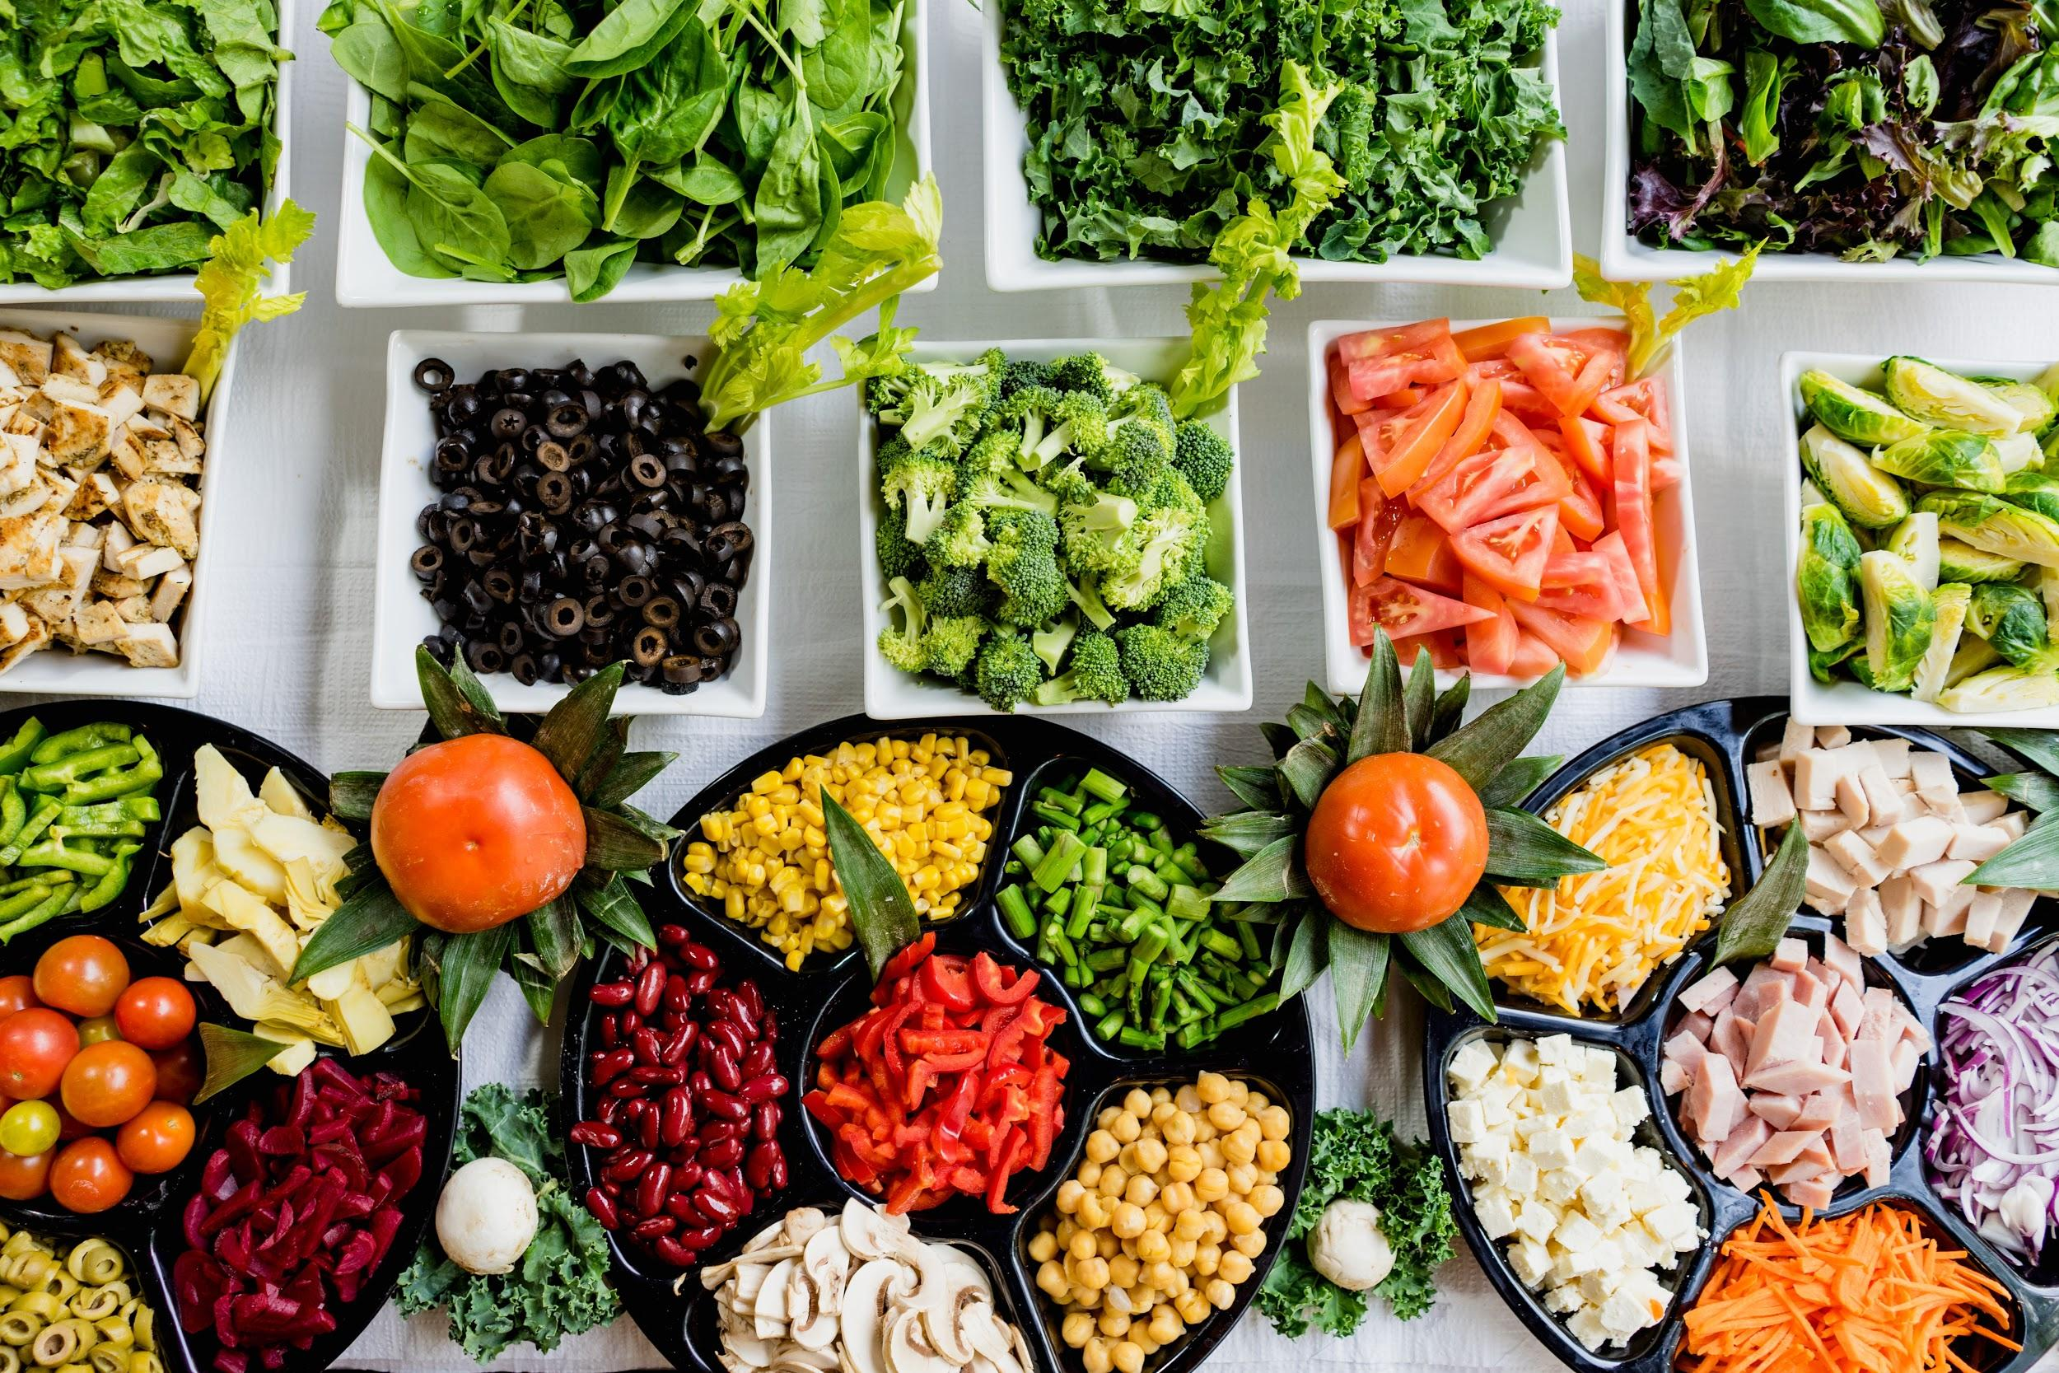
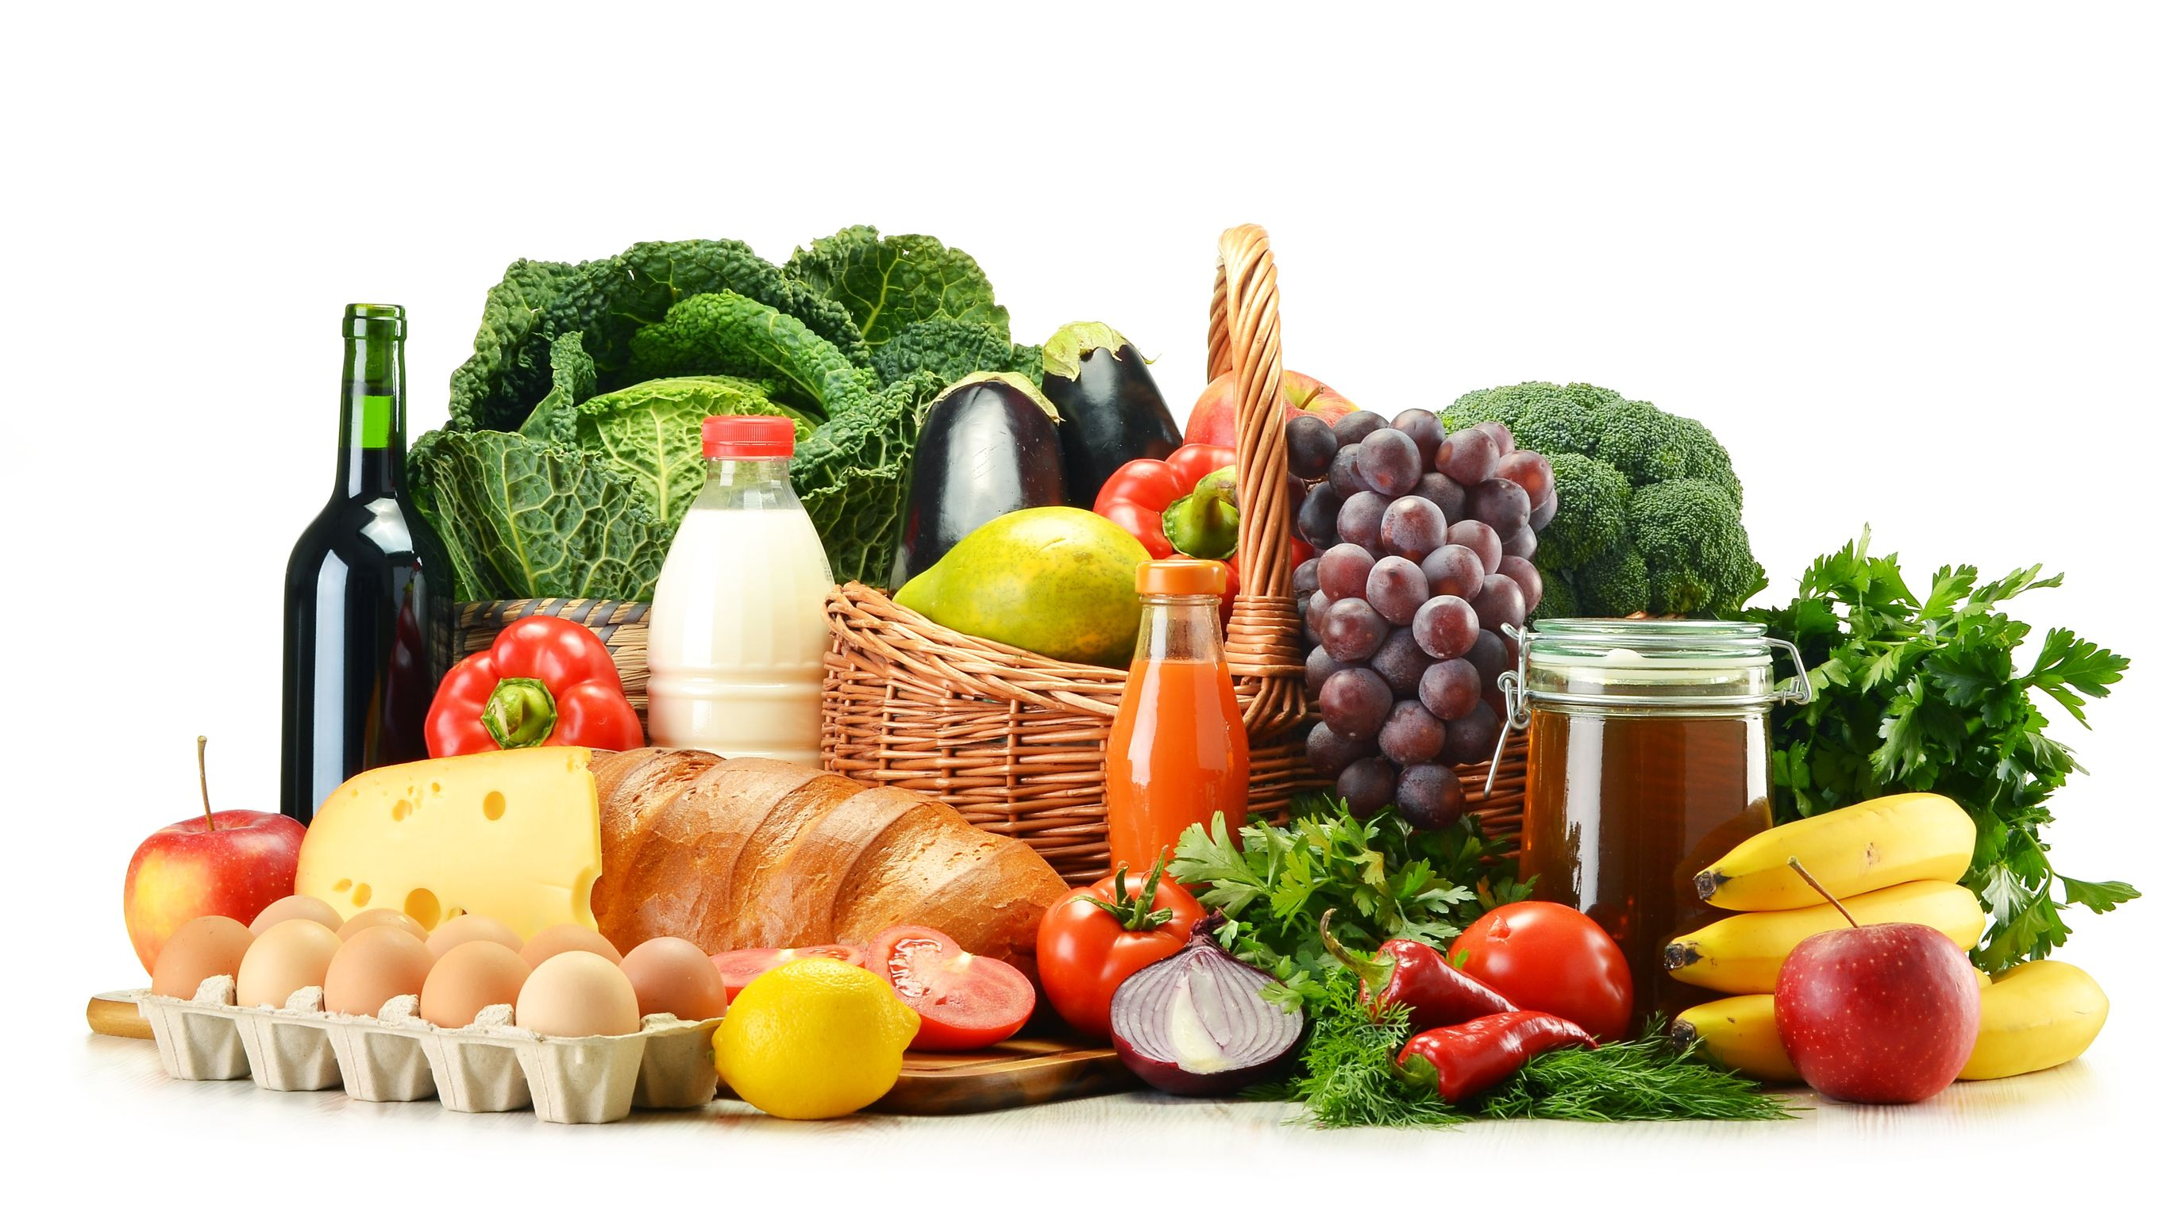
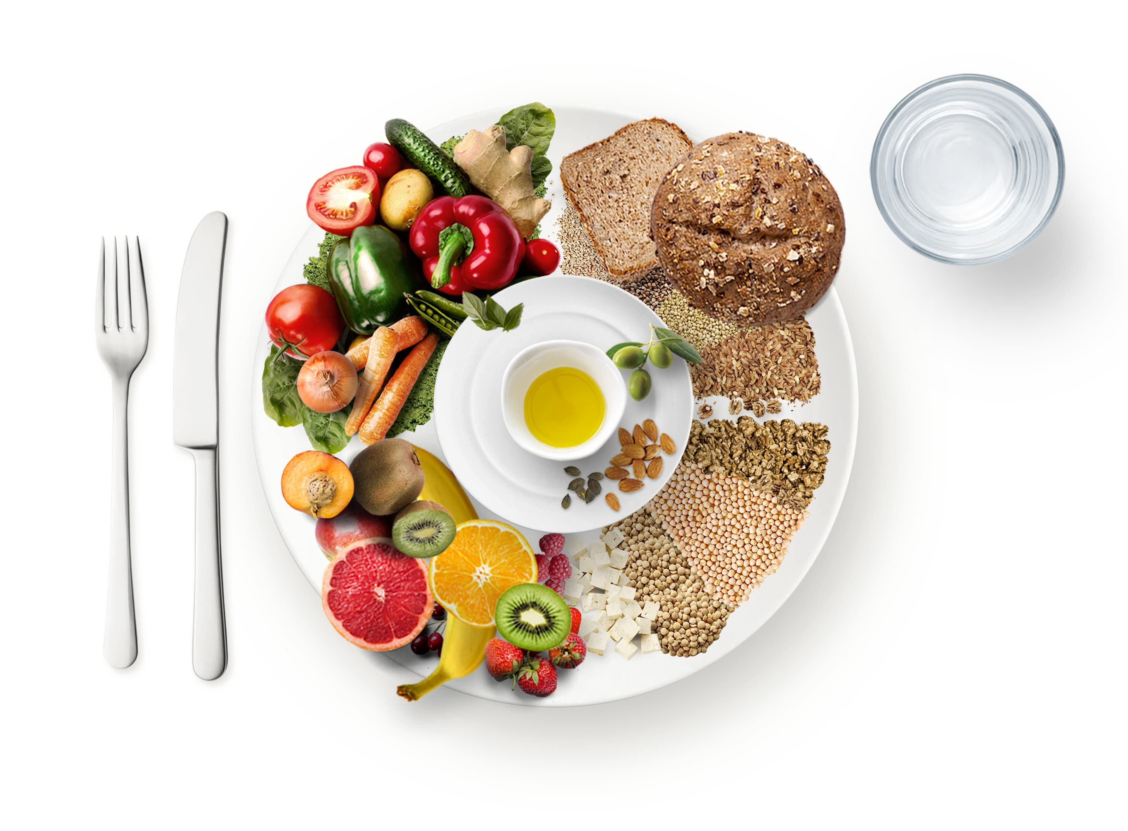
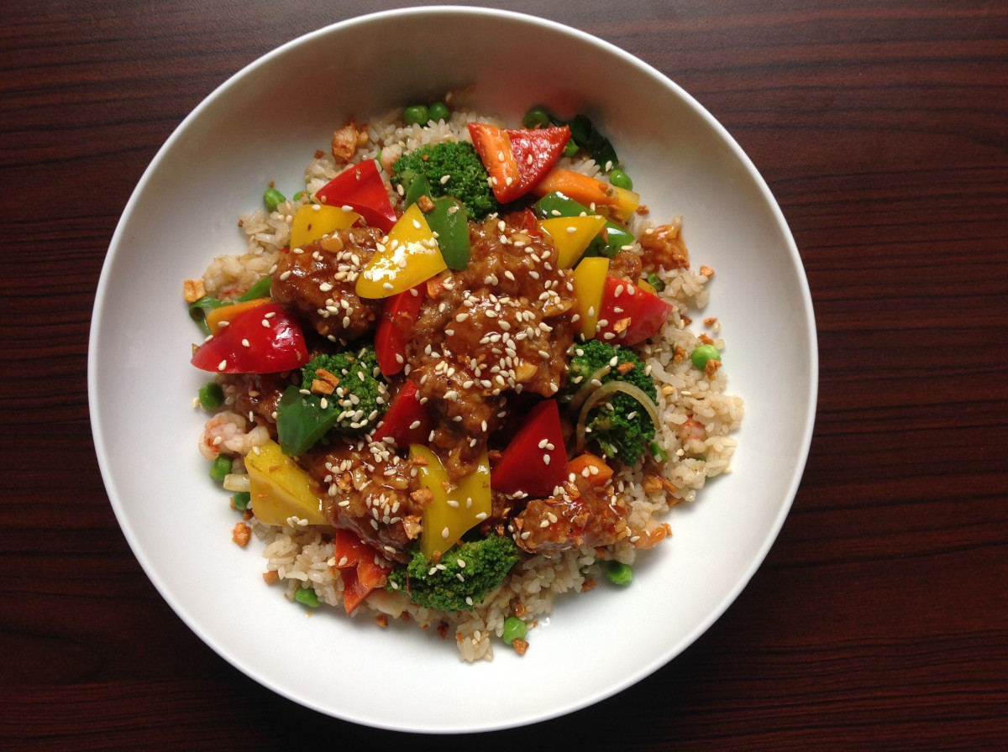

The ultimate goal of our company:
High-Quality Products: Delivering premium food and beverage products that meet stringent quality standards to ensure customer satisfaction.
Nutrition and Health: Focusing on nutritious, healthy, and flavorful options to cater to the growing demand for wellness-oriented products.
Innovation: Continuously improving and innovating their product offerings to stay ahead in the food and beverage industry and adapt to changing market trends.
Sustainability: Emphasizing sustainable practices in sourcing, production, and packaging to minimize environmental impact.
Customer-Centric Approach: Ensuring that the needs and preferences of customers are at the forefront, leading to customized and diverse offerings.
Market Leadership: Aspiring to be a leader in the food and beverage industry by expanding product lines and market reach. These objectives aim to establish Bengal Harvest Food and Beverage Ltd. as a trusted brand that combines health, taste, and innovation while maintaining a commitment to sustainability.
Back

Slide 6


Back
Executive Summary
Bengal Harvest Food and Beverages Ltd is a company focused on producing, marketing, and distributing a range of food and beverage products. It aims to provide high-quality, nutritious, and flavorful offerings to meet the growing consumer demand for healthy and delicious food choices. The company likely engages in sustainable practices and innovation to stay competitive in the food and beverage industry, catering to both local and international markets. Bengal Harvest may also emphasize customer satisfaction, quality control, and adherence to food safety standards in its operations. Bengal Harvest Food and Beverages Ltd is a company focused on producing, marketing, and distributing a range of food and beverage products. It aims to provide high-quality, nutritious, and flavorful offerings to meet the growing consumer demand for healthy and delicious food choices. The company likely engages in sustainable practices and innovation to stay competitive in the food and beverage industry, catering to both local and international markets. Bengal Harvest may also emphasize customer satisfaction, quality control, and adherence to food safety standards in its operations.

Slide 7
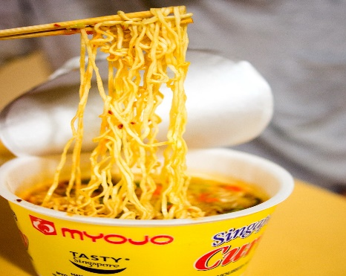

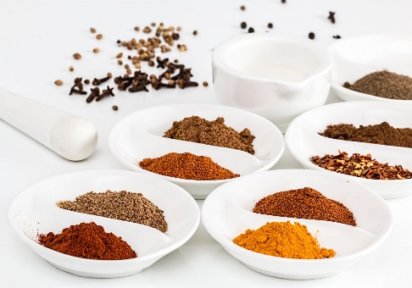
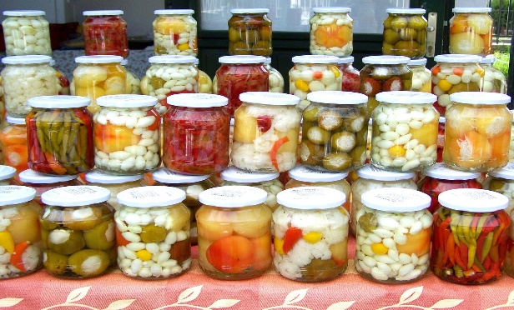
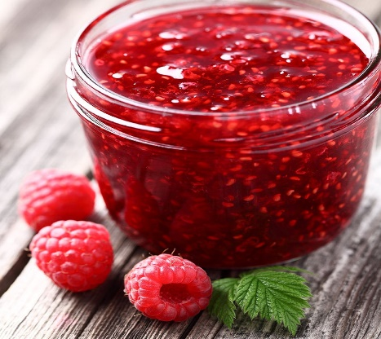
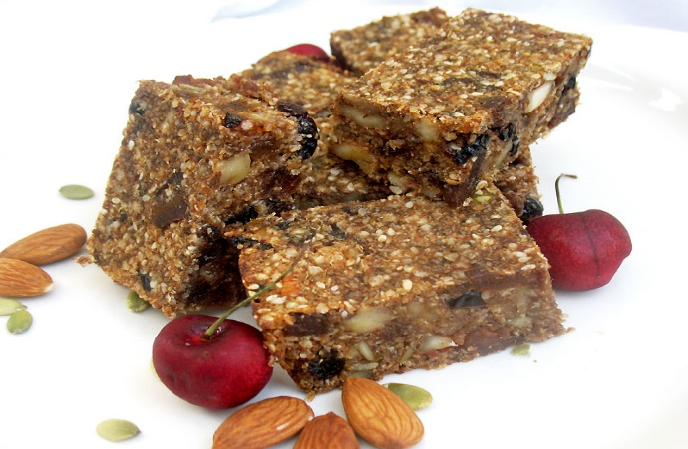


Noodles
Soup
Products
Back
Some Key Products:
Organic Honey
Nuts
Rice
Lentil
Juice
Puffed Rice
See Details
Pickles
Jam
Spices
Energy Bar
Herbs
Yogurt

Slide 8
Business Plan Of Our Company
Back
Market Analysis
Financial Plan
Product Line
Business Plan
Operations Plan
Marketing & Sales Strategy
Branding & Promotion

Slide 9
Sales and Cost Statistics:
Back
Here’s the sales and cost statistics of Bengal Harvest Food and Beverage Ltd. of the year 2023:
Product Name | Cost | Sales
Rice | $22,00000 | $29,00000
Puffed rice | $12,00000 | $15,00000
Spiced nuts | $10,00000 | $12,00000
Instant noodles | $12,00000 | $16,00000
Instant soups | $11,00000 | $13,00000
Jams | $9,00000 | $12,00000
Sauce | $8,50000 | $11,00000
Mango Juice | $10,00000 | $15,00000
Litchi Juice | $9,00000 | $13,00000
Tamarind Juice | $8,00000 | $12,00000
Flavored milk | $15,00000 | $20,00000
Yogurt drinks | $14,00000 | $18,00000
Lentils and pulses | $20,00000 | $23,00000
Spices | $21,00000 | $27,00000
Organic honey | $17,00000 | $22,00000
Herbs | $23,00000 | $30,00000
Energy bars | $18,00000 | $22,00000
Dried fruits | $19,00000 | $23,00000

Slide 10
Back
Conclusion
In conclusion, Bengal Harvest Food and Beverage Ltd stands as a forward-thinking company dedicated to delivering high-quality, nutritious, and flavorful food and beverage products. With a strong focus on innovation and sustainability, the company aims to meet the evolving consumer demand for healthy choices while maintaining a commitment to customer satisfaction. Bengal Harvest strives to be a leader in the industry by prioritizing product excellence and ethical practices, ensuring long-term growth and positive impact on both consumers and the environment.
Contact
If you want to purchase any product you can contact me through:
01875681514
Dhaka
Bangladesh
aminakhatunera3@gmail.com.

Slide 11
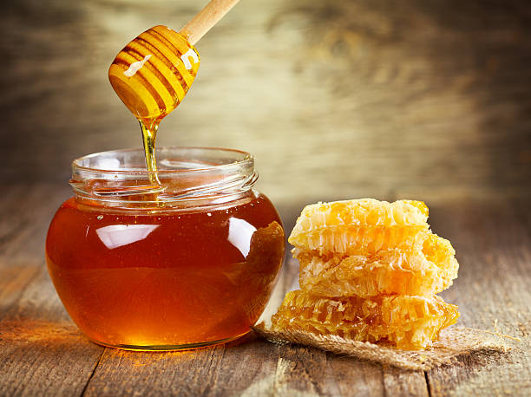
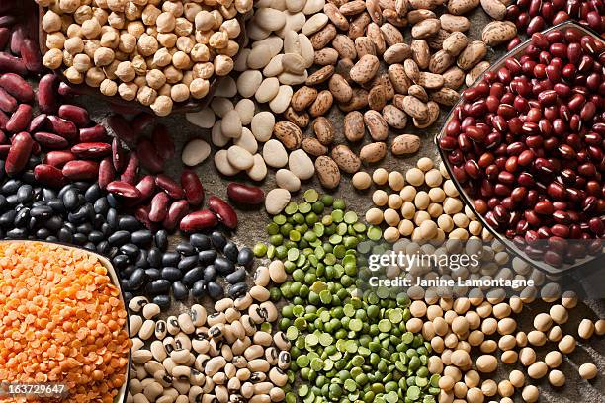
Back
Do You Have Any Question?

